Slide 1
Welcome New Students
Overview of Campus life

Slide 2
Why Choose Us?
Beautiful campus
Experienced professors
Low cost for attendance

Slide 3
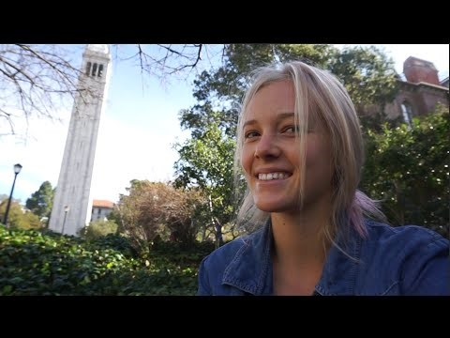

Slide 4
Campus Life Benefits
New, modern co-ed dorms
Recently renovated
Best food cooked by top chefs
Designed to cultivate your dining experience
Easy walking to parks
No car needed!

Slide 5


Slide 6
CE Courses
Department | Course Name | Manager
IT | A+ Certification | Kim Jones
Welding | Welding Basics | John McMurray
Nursing | CAN | Jennifer Herwig

Slide 7
Certification | # Courses Required | # Hours | CEU’s Earned
A+ Certification | 1 | 50 | 3
Nursing | 11 | 130 | 10
Photography | 6 | 70 | 7

Slide 8
Board of Directors
Pam Moore
Board Chair
Tom Allen
Vice Chair
Jimmy Gooding
Committee Chair
Gerald Rainey
Treasurer

Slide 9

Student Count by Program Area

Slide 11
Welcome New Students
Overview of Campus life

